Slide 1
Predicting and Explaining Caravan Policy Ownership
Manohari Wijesooriya
Student #501212269

Slide 2
Introduction
Insurance company is looking for predictive modelling solution to reduce the cost of marketing of their new product, caravan insurance to internal customers.
Given sociodemographic and product variables, they are requesting to flag best possible customers to reach out to sell their product.
Various machine learning algorithms were used in the effort in predicting
Recommendations – Use Naïve Bayes algorithm for prediction

Slide 3
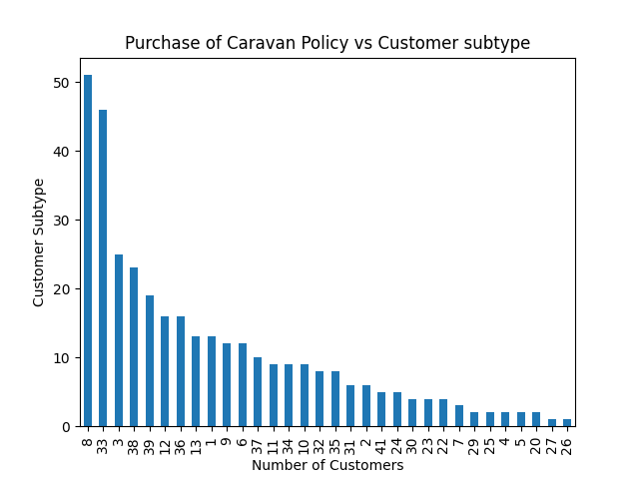
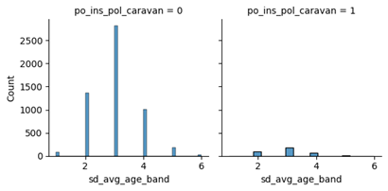
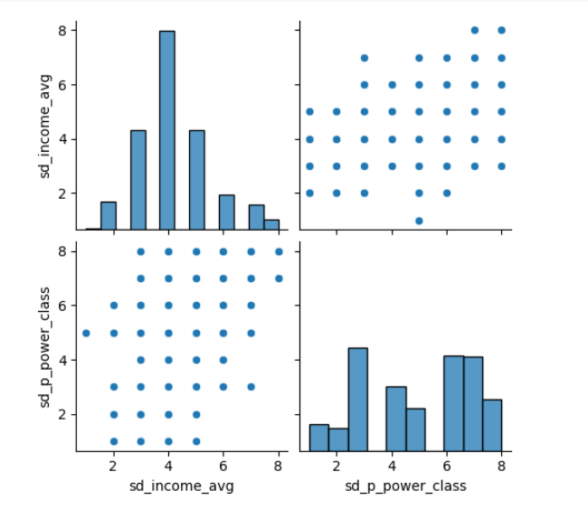
Data Preparation - Exploration
Distinct profiles of Caravan Insurance customers based on sociodemographic data
8 Middle class families
33 Lower class large families
3 High status seniors
38 Traditional families
39 Large religious families
Most customers are in age range of 40 - 50 years
Most customers are middle class families or lower class large families
High average income for higher purchasing power class

Slide 4
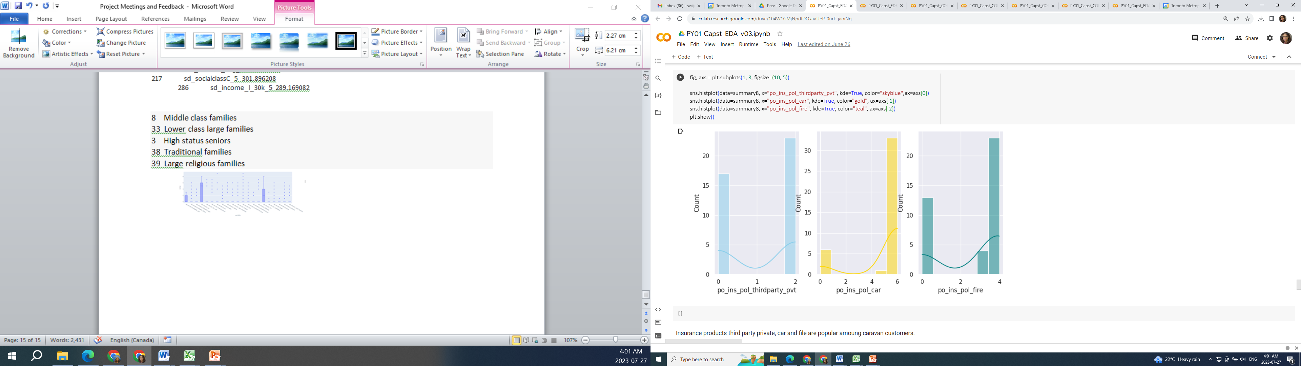
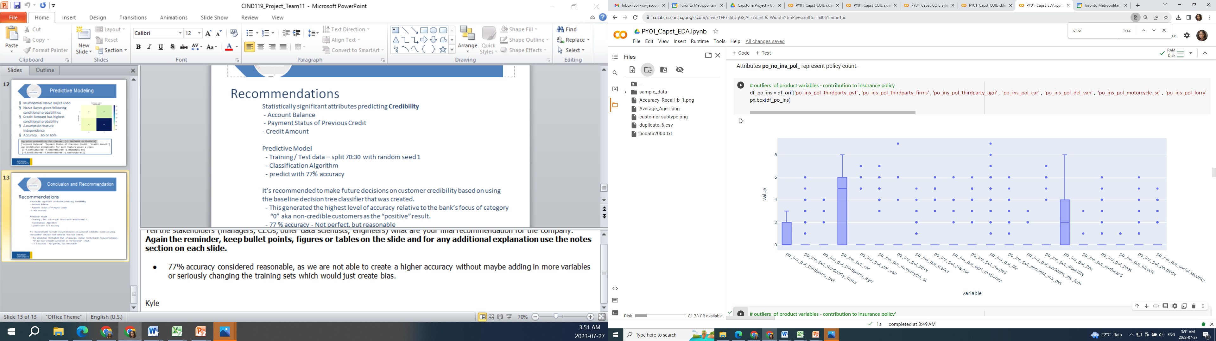
Data Preparation - Exploration
Distinct profiles of Caravan Insurance customers based on Product data
Lower third party insurance premiums
High car insurance premiums
High fire insurance premiums
Popular products are third-party private, car and fire policy.

Slide 5
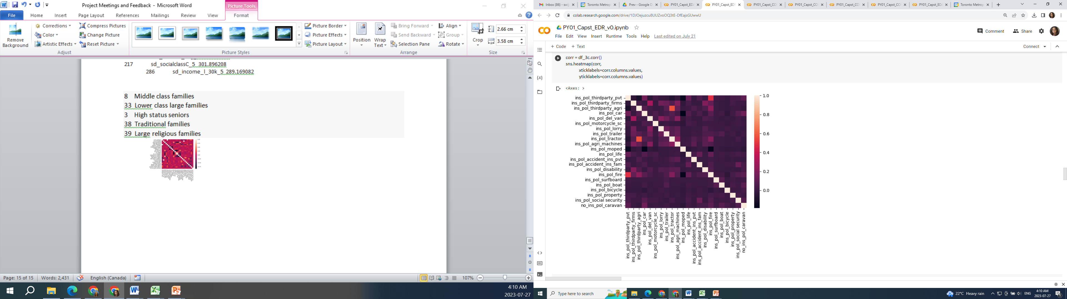
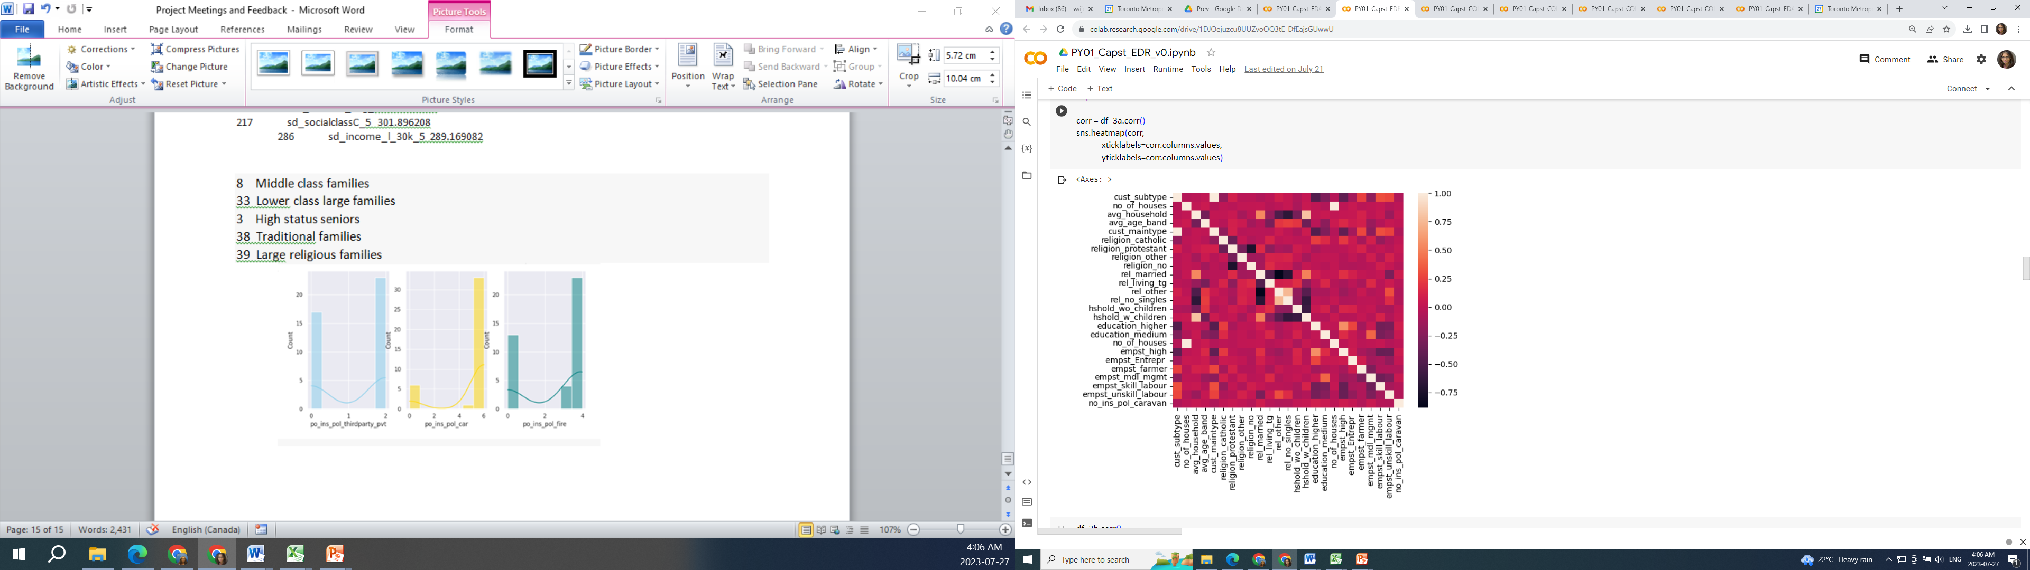
Data Preparation - Exploration
Correlation Matrix
Product data
Sociodemographic data

Slide 6
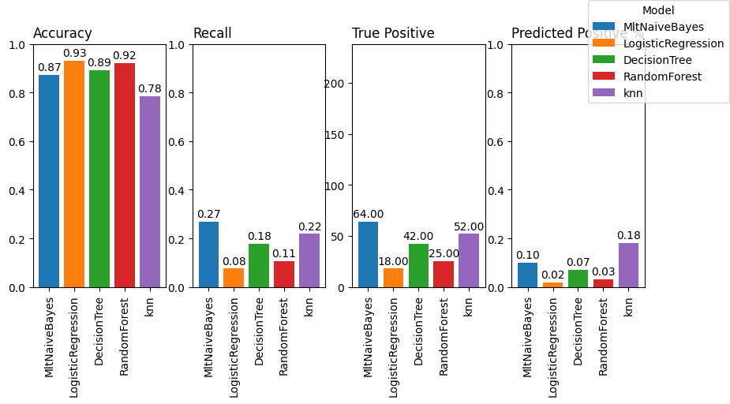
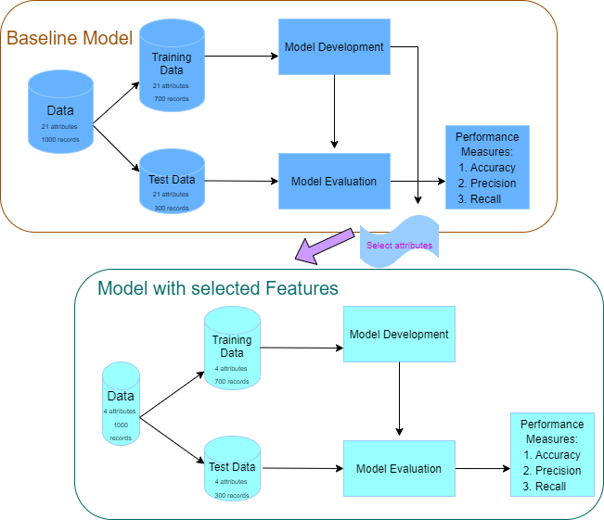
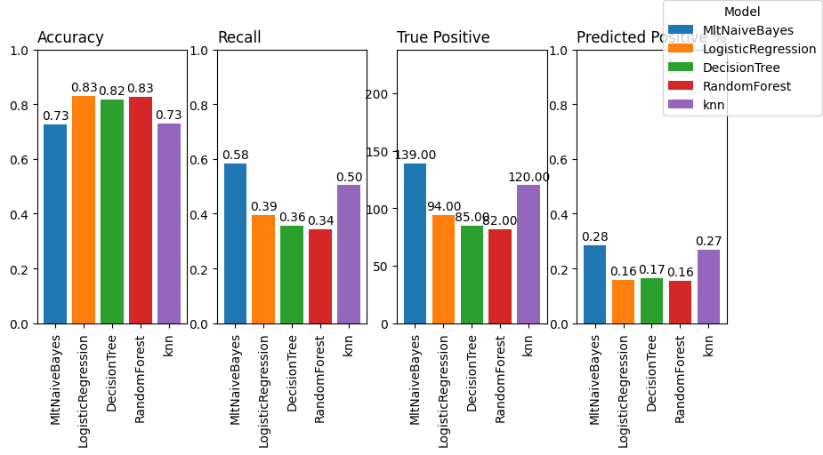
Predictive Modelling
Baseline model
Initial model criteria
Validation/test split : 70/30, random state 7
Sampling technique : SMOTE
Encoding categorical attributes
Final model
Notes:
I started using 5 models as the baseline. Naïve Bayes, Logistic Regression, Decision Tree and Random Forest algorithms and K Nearest Neighbors.
426 variables were used in Baseline model
Validated base line model with test dataset and noted results.
Most important columns were selected using chi squared value. Selected a set of features, ran the model and evaluated results with the test set.
Feature selection techniques used.
- Removing attributes with low variance
- Removing attributes that has high correlation to another variable
- Selecting variables based on best chi squared value

Slide 7
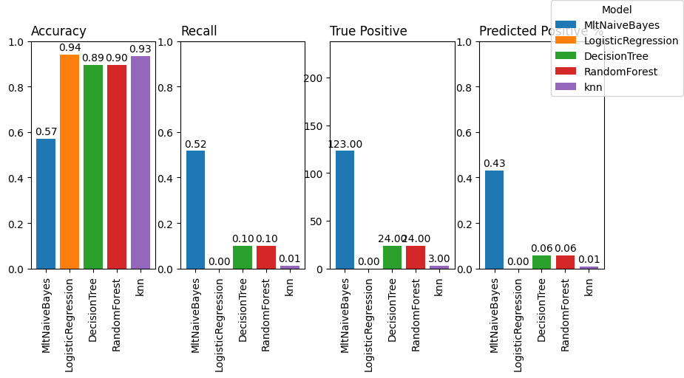
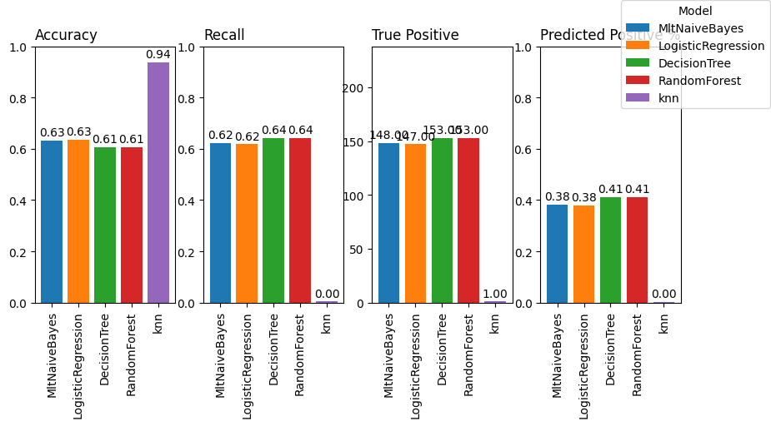
Predictions by segments of Data
Predicting a customer's likelihood to purchase Caravan Insurance based on their product characteristics
Best model - Decision Tree , Random Forest
Accuracy 64% True positive = 153
Predicting a customer's likelihood to purchase Caravan Insurance based on their sociodemographic characteristics
Best model - Naïve Bayes
Accuracy 57%, True positive = 123
Best features
Attribute | Score
sd_religion_other_2 | 71619.19
sd_empst_unskill_labour_2 | 62334.3
sd_income_l_30k_2 | 61913.47
sd_education_medium_3 | 61581.3
sd_religion_protestant_5 | 61457.34
Best features
Attribute | Score
po_ins_pol_car_6 | 387.4142
dr_car_tptypvt | 367.1447
po_ins_pol_car_0 | 356.6783
po_no_ins_pol_car | 257.3392
po_ins_pol_thirdparty_pvt_2 | 183.6167
Notes:
When only production features are selected models Naïve Bayes, Logistic Regression, Decision Tree and Random Forest algorithms give similar results.
With product characteristics, model predicted higher true positive count than the model using sociodemographic and product data.

Slide 8
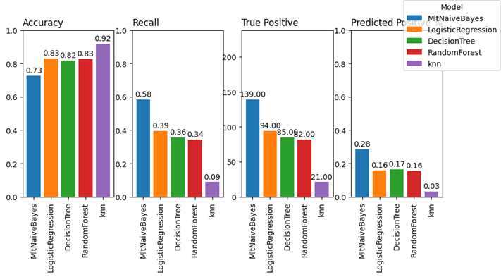
Predictions by segments of Data
Predicting a customer's likelihood to purchase Caravan Insurance based on their sociodemographic and product characteristics
Best Attributes
Attribute | Score
po_ins_pol_car_0 | 723.2143
dr_car_tptypvt_1 | 584.9565
dr_car_tptypvt_0 | 444.7121
po_ins_pol_thirdparty_pvt_0 | 414.5592
sd_empst_skill_labour_3 | 404.4648
po_ins_pol_car_5 | 363.6918
sd_empst_unskill_labour_3 | 340.1657
sd_income_avg_3 | 310.5957
sd_socialclassC_5 | 301.8962
sd_income_l_30k_5 | 289.1691
Best model - Naïve Bayes
Accuracy 73%, True positive = 139

Slide 9
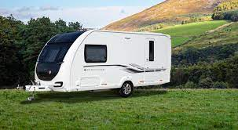
Conclusion and Recommendation
Naïve Bayes is the best algorithm to predict caravan customers.
Model could correctly identify 139 caravan customers out of 238 with 73% accuracy
Model predictions are to contact 28% of the customer base to promote caravan policy
Best predictive attributes are : car policy, private third party policy, average income 3, skill labour 3, unskill labour 3

Slide 10

Thank you,
Chang School,
Professors,
Technical Assistants,
Colleges

